Slide 1
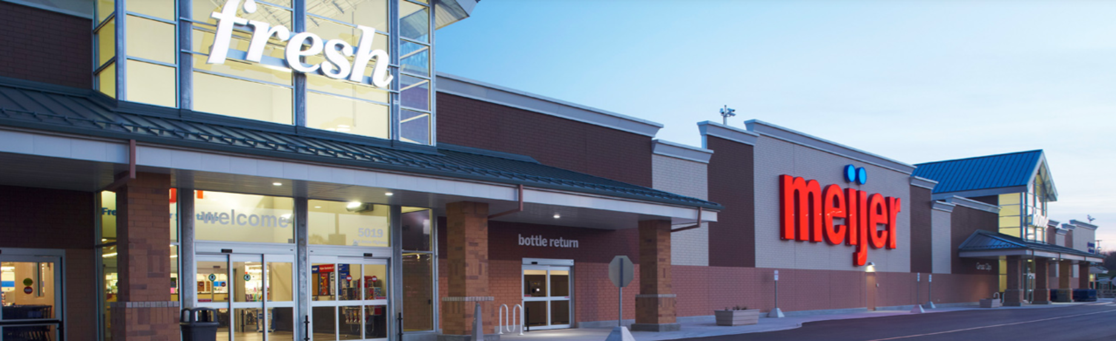
Meijer’s Shopping Carts
DATA604 Final Project
July 18th, 2021

Slide 2
Contents
DATA604
Final Project
Topic About Meijer Cart Problem Flowchart Validity Assumptions Parameters Simulation/Iterations Conclusions Out of Scope | Page 3 4 5 6-7 8 9 10
Using SimPy, write a process simulation that includes waiting time. You may use any topic of interest to you.

Slide 3
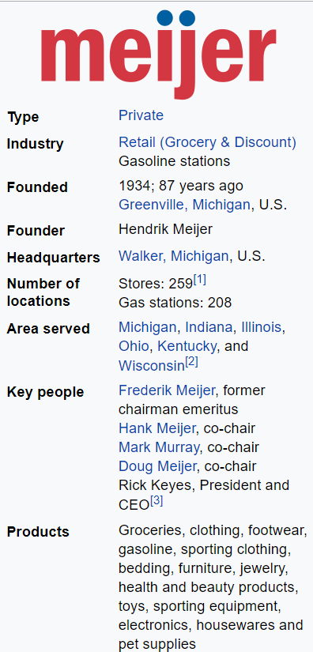
2021
2021
Today
About Meijer
Meijer Inc. …
is an American supercenter chain in the Midwest, headquartered in Grand Rapids, MI
was founded in 1934 as a supermarket chain and is credited with pioneering the modern supercenter concept in 1962
has about half of their 259 stores located in Michigan, with the others in Illinois, Indiana, Kentucky, Ohio, and Wisconsin
ranked…
19th on Forbes magazine's 2015 list of "America's Largest Private Companies”
15th on Supermarket News’ list of Top 75 U.S. & Canadian Food Retailers & Wholesalers
Based on 2015 revenue, Meijer is the 26th-largest retailer in the United States
link to Meijer’s Website
source: Wikipedia

Slide 4
Cart Problem
Problem…
…I’ve been shopping at Meijer at least once a week for over 15 years and I’ve never entered either of their two main entrances at any location and not had at least 25 shopping carts waiting for me. Great customer service, “yes”, but …
…is Meijer buying too many carts?
Significance…
…Shopping carts similar to Meijer’s are around $175 and my personal count at the Grandville, MI store totaled 450 carts. If Meijer truly does have too many carts, then new stores (average of 3 per year) could be supplied with carts from existing stores for an annual savings of $236,250 (450 carts * 3 new stores * $175 per cart)
(see Descriptive Stats slide for details on these numbers)

Slide 5
2021
2021
Today
Flowchart
Meijer Store
in store
Entrance 1
Entrance 2
Parking Lot
Parking Zone 1
Parking Zone 2
Cart return
Returns cart to…
Entrance
Customer
Enters store
Grabs cart
Shops
or
Parking Lot
“Cart Pusher” Employee
Collects carts
Returns to Entrance

Slide 6
Validity - Assumptions
Since Meijer is a privately held company a number of assumptions were made due to limited access to their data.
Assumption | Reasoning
60% of customers enter the store via Entrance 1 and 40% via Entrance 2 | Entrance 1 is where the grocery section is and in my walkthrough had a higher percentage of store traffic.
Customers leave via the same entrance they entered | It would be unusual for a customer to exit an entrance not closest to their car.
90% of customers take their cart to the car. 10% return the cart to the entrance they picked the cart up from. | Given the average basket size of $50, most customers have several bags, so it’s easiest to just wheel the cart out to their car.
Each day at hour 0 (00:01 am), the system is reset to it’s initial state | Meijer is open 24 hours, so it makes sense to reset the cart count at each entrance and the parking lot. Also, carts left in the parking lot at night are more subject to theft.
There are always at least two “cart pusher” employees, but a max of three cart pushers. They collect & return carts to an entrance at the rate of 100 carts/hour (300 per hour is total capacity) | Meijer’s parking lots are large, so it makes sense to have at least one cart pusher for each entrance. 100 carts per hour might sound like a lot, but it does sound logical when stated as, “collect & return 25 carts every 15 minutes”)
The cart pushers help each other out to ensure carts are available at each entrance. | It’s logical to assume that the store does not want a cart pusher to be idle, while his peer falls behind

Slide 7
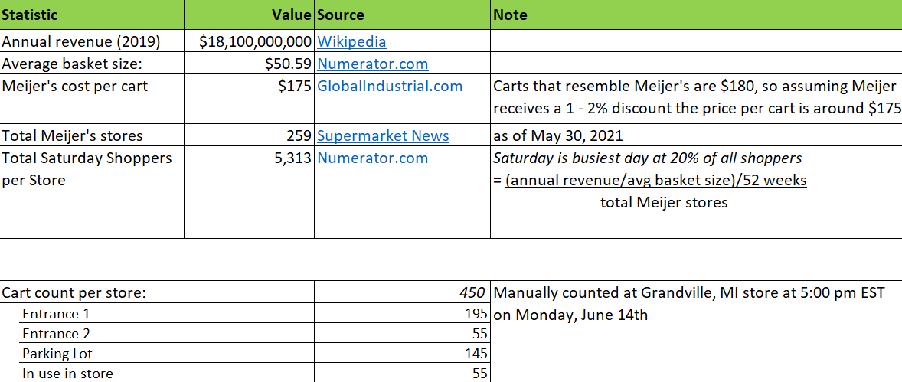
Validity - Parameters
Since Meijer is a privately held company a number of desired parameters for this model were not available due to limited access to their data. Below are the parameters that were found online and those that were derived.

Slide 8
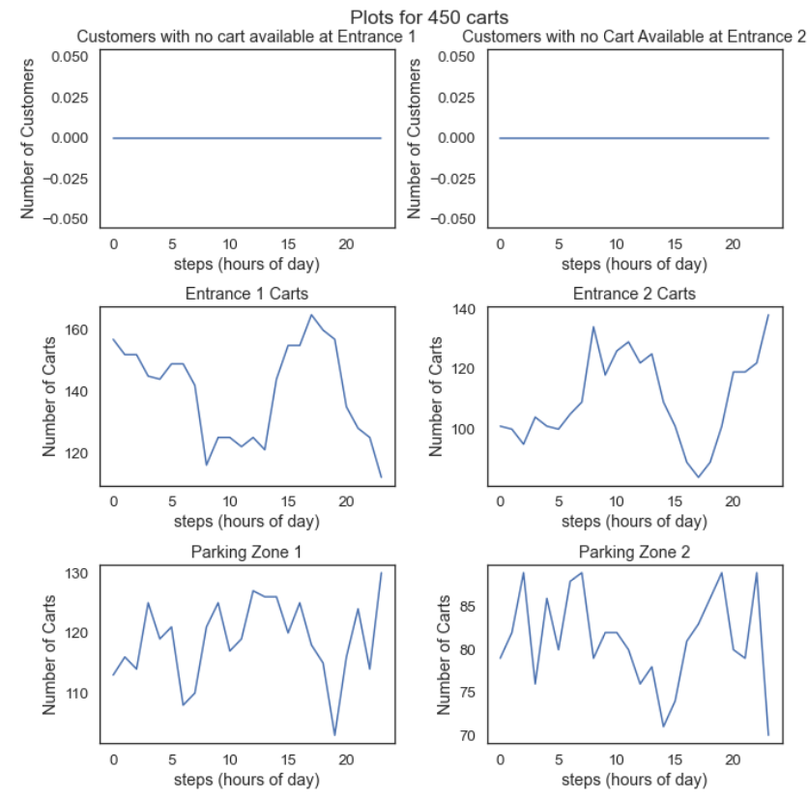
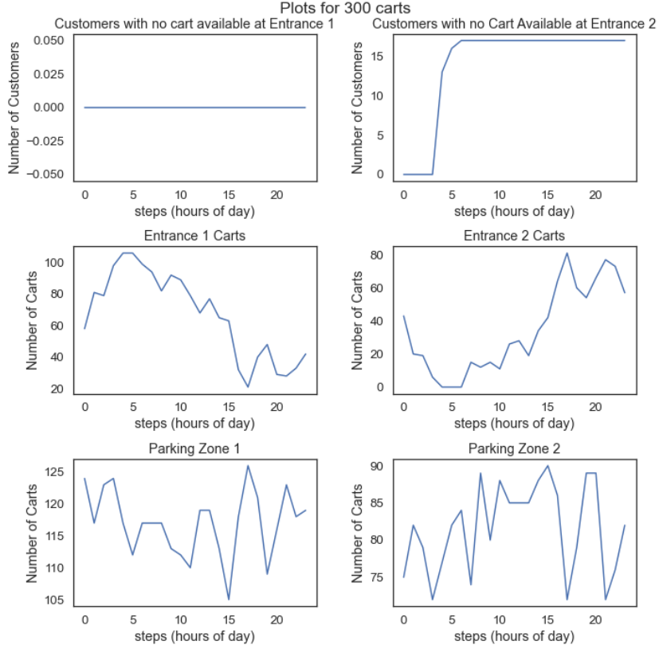
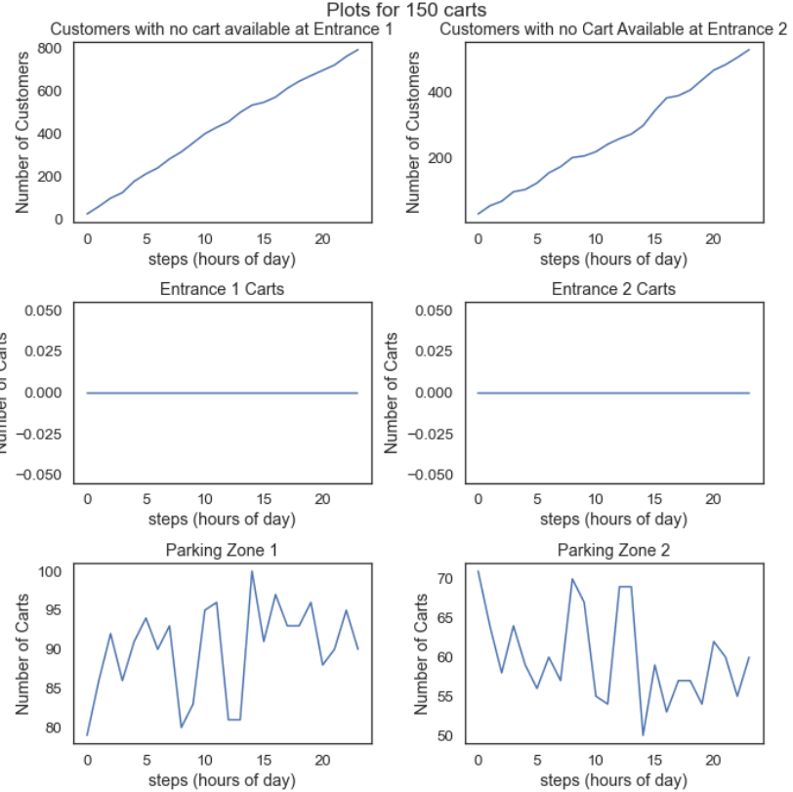
2021
2021
Today
Simulation/Iterations
link to Model’s Notebook
Using the Assumptions and Parameters on slides 6 & 7, this study started the model with 450 carts (Grandville, MI store’s total carts), and decreased carts by 50 per iteration down to 150 carts (450, 400, 350, 300, 250, 200, 150).
link to plots for all 7 iterations
450 carts
300 carts
150 carts
Plenty of carts! Customers had at least 112 carts at entrance 1 and 84 carts at entrance 2.
Increased risk of no carts. 17 customers had no cart at entrance 2. Entrance 1’s low was 21 carts.
Obviously unacceptable. 794 customers at entrance 1 & 531 customers at entrance 2 had no cart.

Slide 9
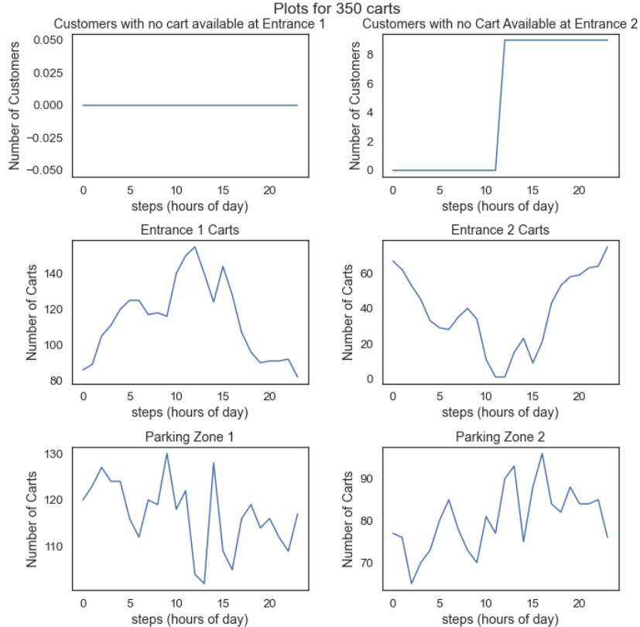
2021
2021
Today
Conclusion
Total savings over 10 years of $525,000
Sweet spot is 350 carts…
Granted at 350 carts, 9 customers had to wait for a cart, but this is most likely a modeling outlier that could be handled via cart pusher training and greeter awareness.
This is a 100 cart reduction from the 450 carts in my personal count at the Grandville, MI store. At $175 per cart * 100 carts, this is saving $17,500.
If Meijer applies this reduction to new stores by transferring carts from existing stores, at 3 new stores per year, they’d save $52,500 (3 * $17,500)
Additional ideas…
See “Out of Scope” on the next slide for ways to improve this model
In addition to it’s current use identifying the right cart count, this model could be used to model the number of cart pushers and the cart return rate per cart pusher.

Slide 10
2021
2021
Today
Out of Scope
To contain the scope of this project, and due to limited real-world data, the model does not account for the statements below. If this model were to be expanded upon, these would be good items to add.
Statement | Reasoning
This model assumes that all customers desire a cart (don’t choose a basket) | Factoring in the impact of customers selecting baskets instead of carts is beyond the scope of this project, particularly given the lack of data
Online shoppers and in-store Shift shoppers are not accounted for | The behavior of Shift shoppers is different, i.e. they would probably keep the same cart for the duration of their shift, and would shop many orders.
The number of customers in the store more than one hour is not statistically significant for this model | It’s beyond the scope of this project to factor in the added complexity if there is a statistically significant percentage staying beyond one hour.
Number of customers per hour is consistent over the 24 hours | This is not true in real life, but decided it is beyond scope of this project to account for variation in shoppers per hour

